Slide 1
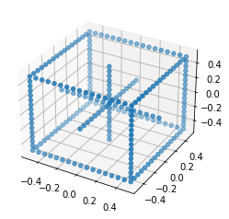
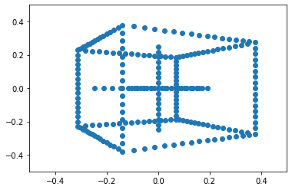
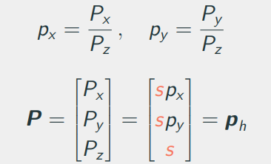
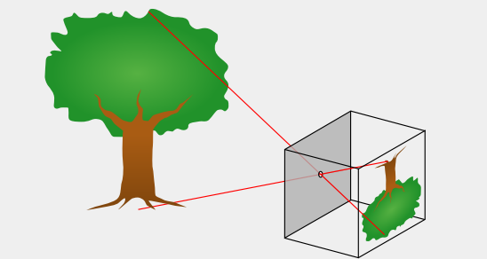
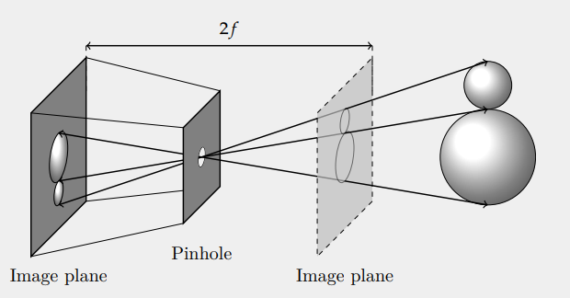
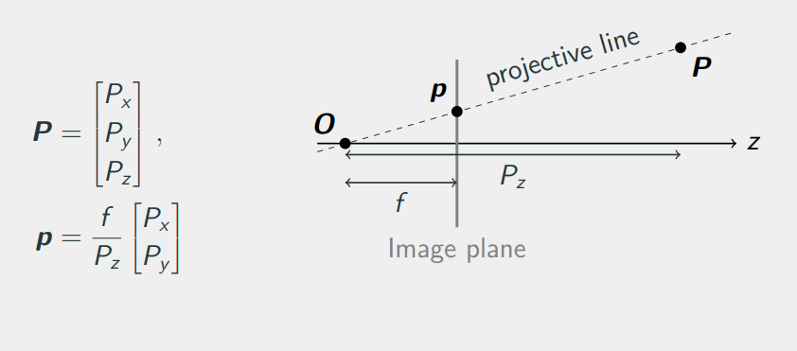
Pinhole camera model & Homogeneous coordinates q = K[R|t]Q = PQ

Slide 2
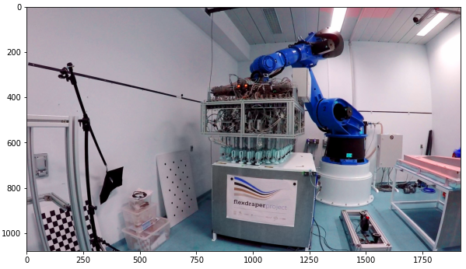
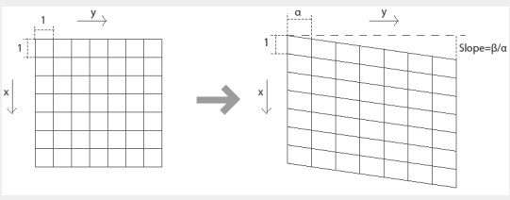
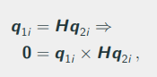
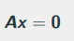
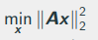
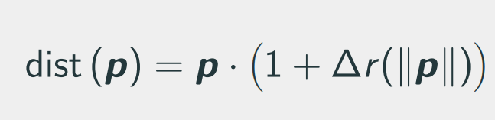
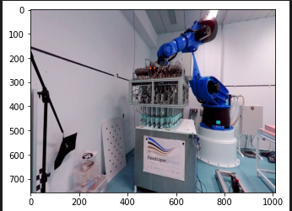
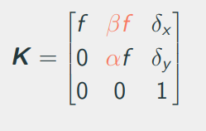
Camera model & Homographies
Camera model parameters, non-square/rectangular pixels
Origin of distortion and treatment
Homography derivation, use & interpretation
Linear algorithm for estimating H (parallel vectors, least squares by SVD)

Slide 3
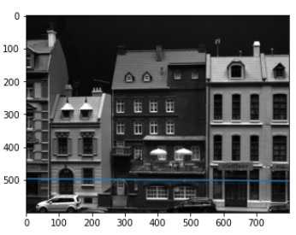
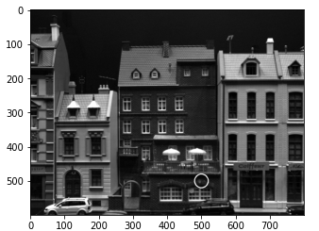
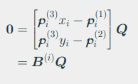
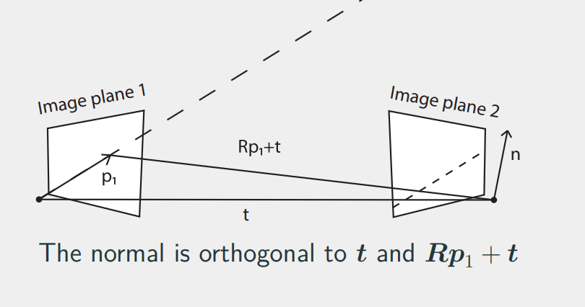
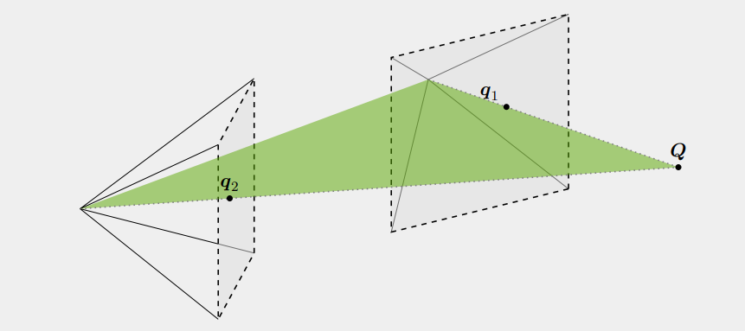
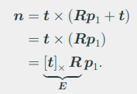
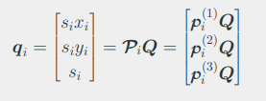
Stereo vision & triangulation. Multiview geometry. Essential & Fundamental matrices. 0 = p1’Ep2; 0 = q1’Fq2; p - 3D; q – 2D projection.
Derive and apply Fundamental & Essential matrices
The derivation of Essential uses the normal of epipolar plane interpretation, but could also be an epipolar line
Linear algorithm for triangulation
Pros & cons of linear algorithm

Slide 4
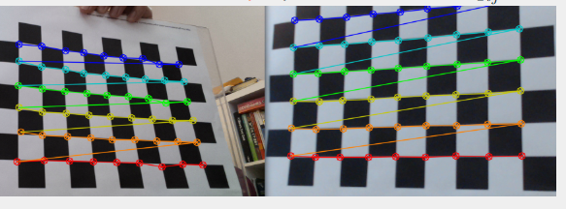
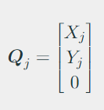
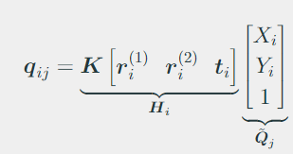
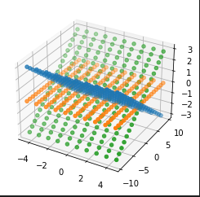
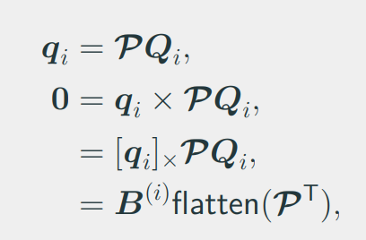
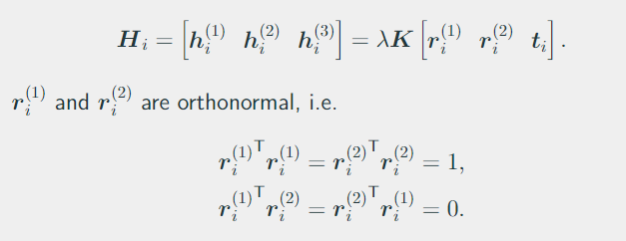
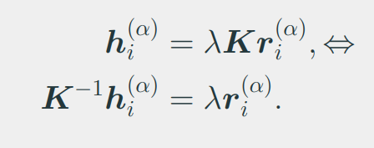
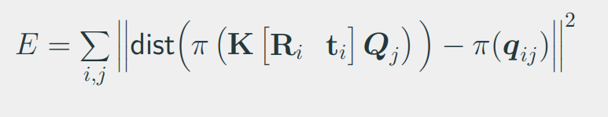
Camera calibration & DLT
Explain DLT for P estimation, n of DoF, required constraints
Zhang’s method. Pattern. Correspondences. Find Homographies by SVD. Express ri in terms of h. Extract the relevant info from solution
Non-linear calibration least squares error between observations & projections

Slide 5
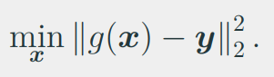
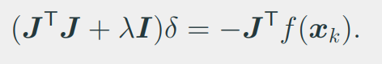
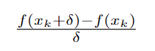
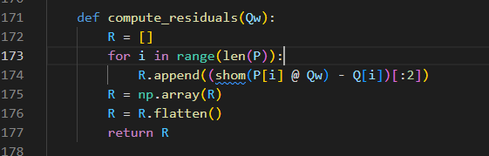
Non-linear triangulation & calibration. Rotations. Bundle adjustment.
Optimization. Levenberg-Marquardt. Could be used for many of the problems we encounter: homography est, camera calibration, triangulation…
Jacobians: analytical, autodiff (ex. pytorch) or simply finite difference approximation (Taylor series, forward, backward, central 2nd order)
Rotation representations. Euler – minimal, suffers from gimbal lock. Axis angle – theta around axis. Quaternions – gold standard.
Bundle adjustment – after having the parameters optimize over all points including 3D positions of corners.

Slide 6
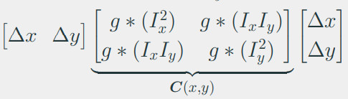
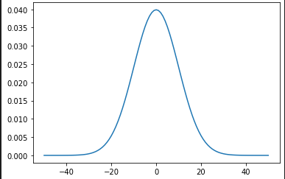
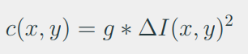
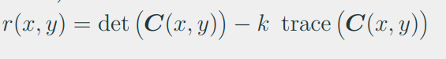
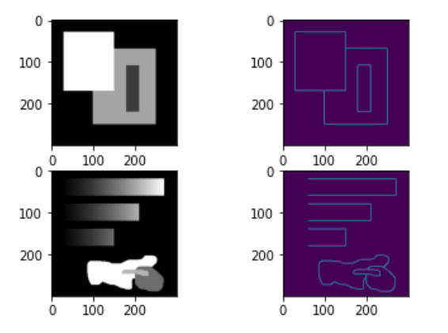
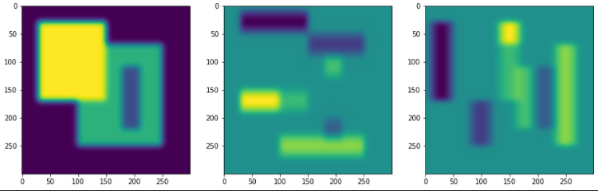
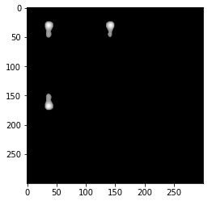
Simple features. Canny. Harris
Image correspondence (problems: scale, rotation, translation, lighting)
Image features (key points, focus on the area around pixel, describe)
Explain image filtering (gaussian kernel). We know analytical derivative of gaussian filter.
Harris corner is defined as having large gradient in all directions. We can get this metric from the averaged Hessian matrix. C(x,y) – smoothened H
c(x,y) has large value regardless of deltas. Looks at C(x,y) det & trace
Expanded
Corner measure (Harris)

Slide 7
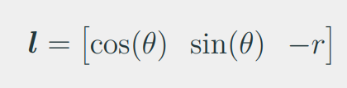
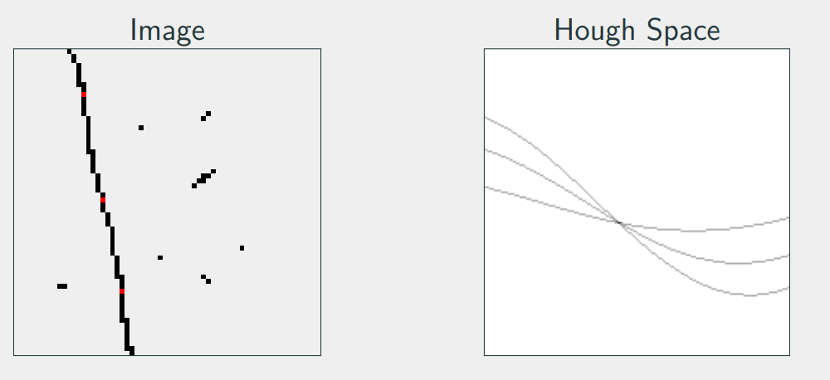
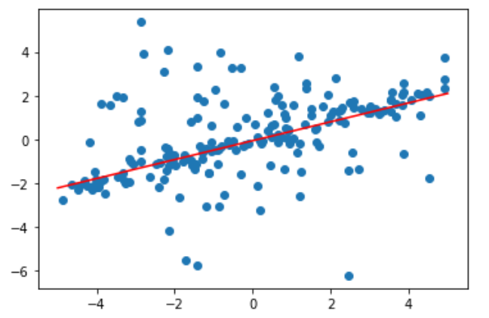
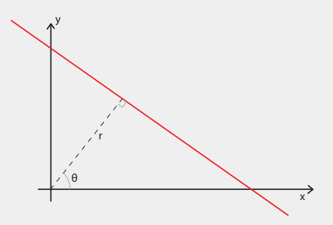
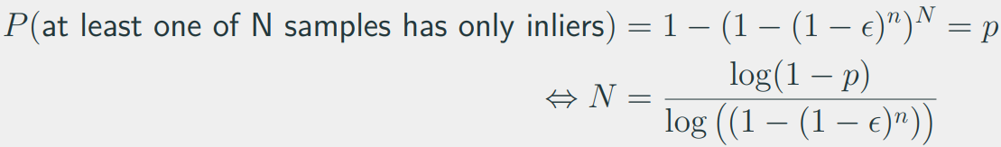
Robust model fitting. RANSAC. Hough transform.
Hough transform – r,theta representation. Idea: we can sample our original image and draw all possible lines going through that point in Hough Space. Do that for all points, the maximum intensity will represent line in original image.
We can generalize to more complex models, but it becomes impractical for more than three degrees.
How many iterations do we need to be happy about the model? Epsilon – fraction of outliers. This can be done adaptively too.

Slide 8
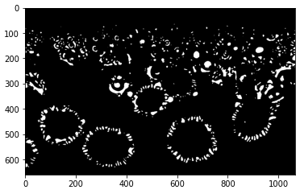
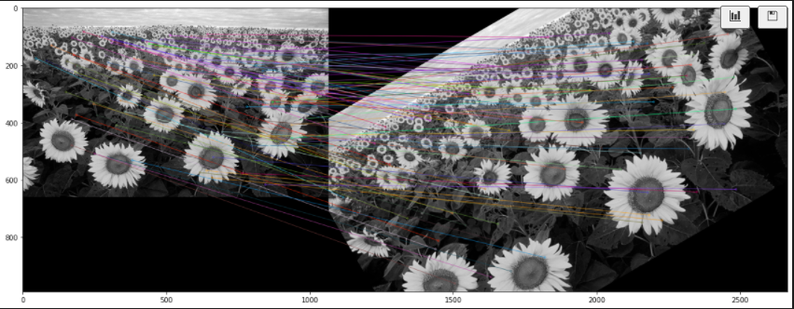
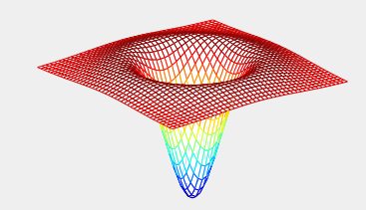
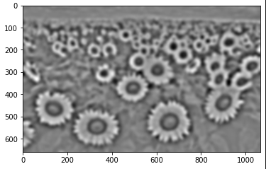
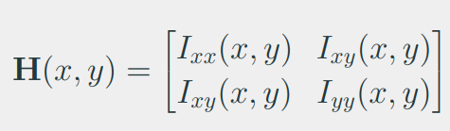


Blobs & SIFT
Blob – binary large object. Large gradients. Areas that…
H measures curvature at a pixel. Trace of H is what we use for blob detection (essentially intensity of curvature, point of interest bc of this property).
DoG gives an approximation of trace(H).

Slide 9



Constrained geometry feature matching
Eight-point algorithm (Fundamental matrix). Degrees of freedom, one pair fixing single.
RANSAC for improving the estimate. Sampson’s Distance.
Choosing threshold for RANSAC. Chi-square Distribution Table. m is taken from error dimensions; ex. Euclidean distance is two numbers.

Slide 10




Image stitching
Why can we use Homograhies for panoramas? We assume that world is flat if there is no translation only rotation.
RANSAC for fitting Homographies. Error measure? – map both pair point back and forth and take squared difference between pair in the sample.
We can use Homography to warp image to our current field of view. Take the average in overlapping areas.

Slide 11




Visual odometry
SIFT (or any other), matching
Essential matrix, RANSAC, DoF, decomposition (R,t)
Scale of t is unknown, we can fix it from the first two frames
Use the translation between the first two cameras to fix the scale?
Triangulation of two images
PnP to estimate pose of camera in third by 2D=>3D pairs. RANSAC again

Slide 12







Structured light
Idea: shine a laser line, capture it in camera, triangulate as intersection of pixel and laser plane (but requires calibration & slow)
Better go for surface encoding with spectrum. Discrete/continuous.
Passive setup uses stereo
Rectification
Unwrapping, sinusoidal pattern
Matching pixels
Disparity map
Triangulate matches on epipolar lines

